Slide 1
Day 4
Going Live
October 24, 2017

Slide 2
Check-Up Session
How’s it going?
After 1 week of Bootcamp, how are you holding up?
What feedback do you have so far?

Slide 3
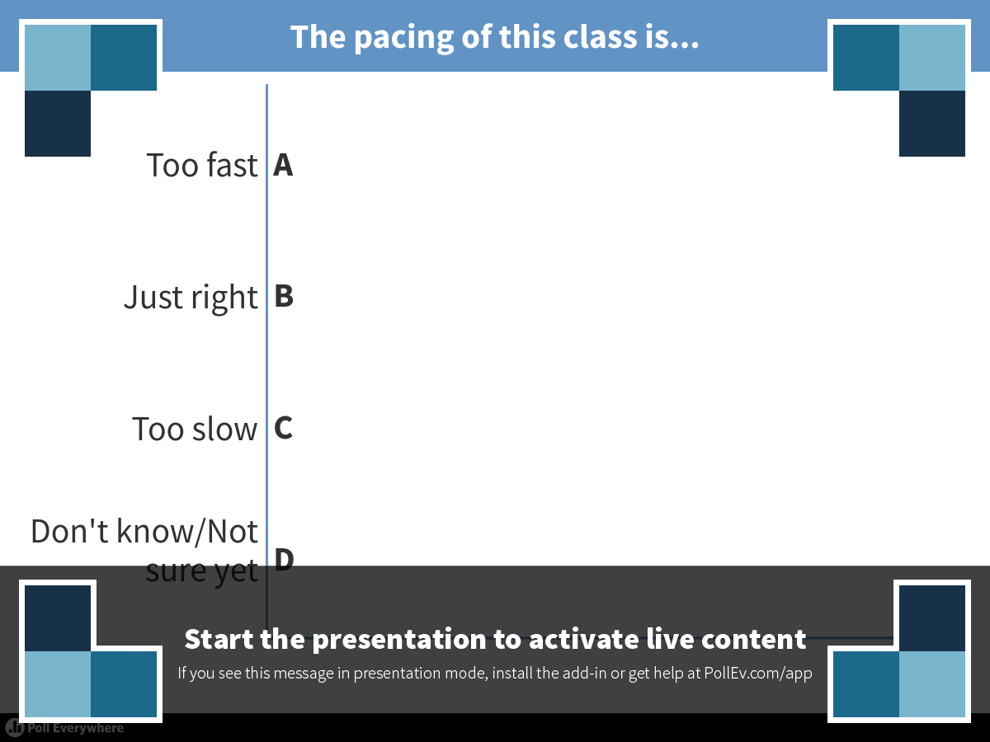
Notes:
The pacing of this class is...
https://www.polleverywhere.com/multiple_choice_polls/nyhEqISMdr1au8W

Slide 4
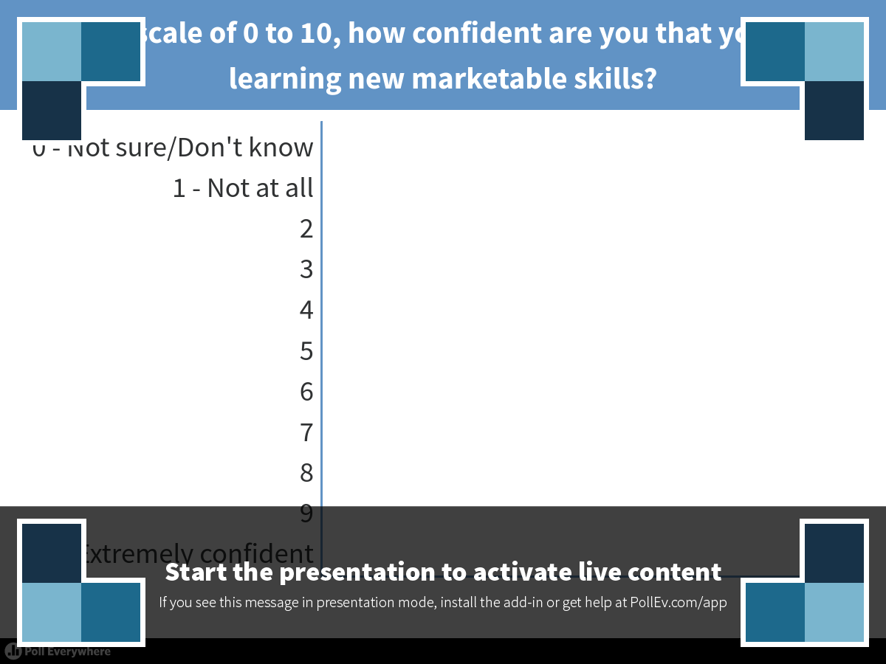
Notes:
On a scale of 0 to 10, how confident are you that you are learning new marketable skills?
https://www.polleverywhere.com/multiple_choice_polls/J8vSCU4NYrQoYga

Slide 5

Instructor Feedback
Seriously, mind-blown.

Slide 6
Instructor Feedback
Things I’ve noticed people doing incredibly well:
All of you are handling an enormous volume of information.
All of you are asking the right questions.
You notice the right details.
You all help each other out.
And, most importantly, you are figuring out things on your own.

Slide 7
A Few Admin Things…

Slide 8
Instructor Feedback
Remember, Homework #1 is due on Saturday.
Homework Link:
http://ucb.bootcampcontent.com/UCB-Coding-Bootcamp/10-16-2017-UCB-Class-Repository-FSF/tree/master/01-Class-Content/01-html-git-css/02-Homework/Instructions
Remember to submit Homework via GitHub (& GitHub Pages):
https://bootcampspot-v2.com/
And seriously!
Submit whatever you have! Don’t get a 0.
(Even if you don’t like what you’ve made.)

Slide 9
Office Hours + Additional Help
Also, remember….
In Class Office Hours: 45 minutes before class, 30 minutes after.
Review In Class Material (Exercises and Slides):
http://ucb.bootcampcontent.com/UCB-Coding-Bootcamp/10-16-2017-UCB-Class-Repository-FSF/tree/master/01-Class-Content/01-html-git-css/01-Activities
Re-Watch Class Videos:
https://codingbootcamp.hosted.panopto.com/Panopto/Pages/Sessions/List.aspx#folderID=%2215c5ef57-dff5-4057-babc-7c23c9e4919e%22&folderSets=3

Slide 10
Recapping

Slide 11

Recap
In just one whirlwind week we’ve covered:
Full-Stack Development Conceptually
Terminal / Git Bash
HTML Syntax
Git Concepts and Commands
CSS Purpose, Syntax, and Styles
Floating
Positioning
Box Model
Chrome Dev Tools
How to Learn on Your Own!!

Slide 12

Full-Stack Development?

Slide 13
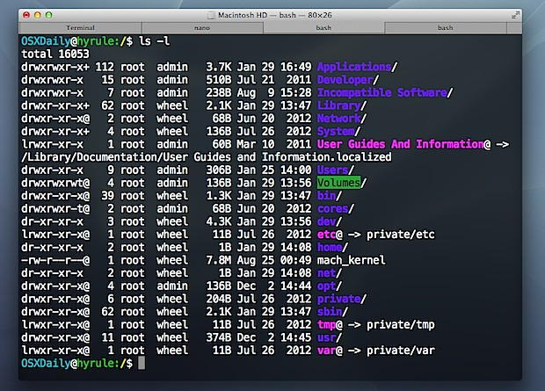
> Intro to Console

Slide 14

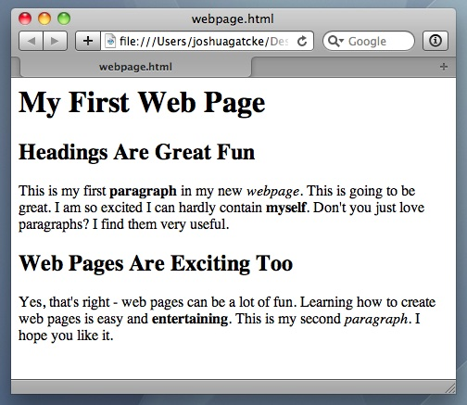
<title> Intro to HTML </title>
HTML is one of the three base languages behind every single website.
It defines all of the basic content and a bit of formatting.

Slide 15



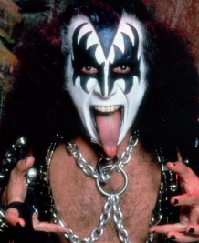

Pushing and Pulling to GitHub
1
2
3
4
GitHub Branch
Pull Code
Push Code
Pull Code
Pull Code
Push Code
Pull Code
Push Code

Slide 16
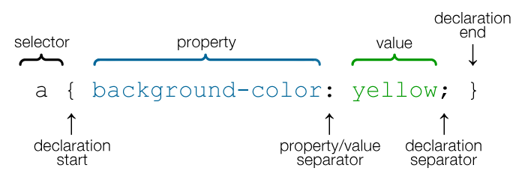
CSS Syntax
CSS works by hooking onto selectors added into HTML using “classes and identifiers”.
Once hooked, we apply styles to those HTML elements using CSS.

Slide 17
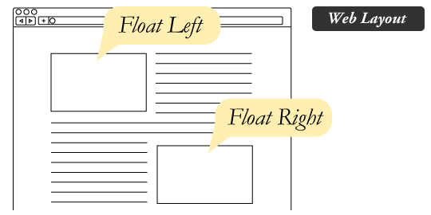
The Concept of “Flow”
In HTML/CSS, (by default) every element displayed is governed by a concept called “flow.”
This means that HTML elements force their adjacent elements to flow around them.

Slide 18
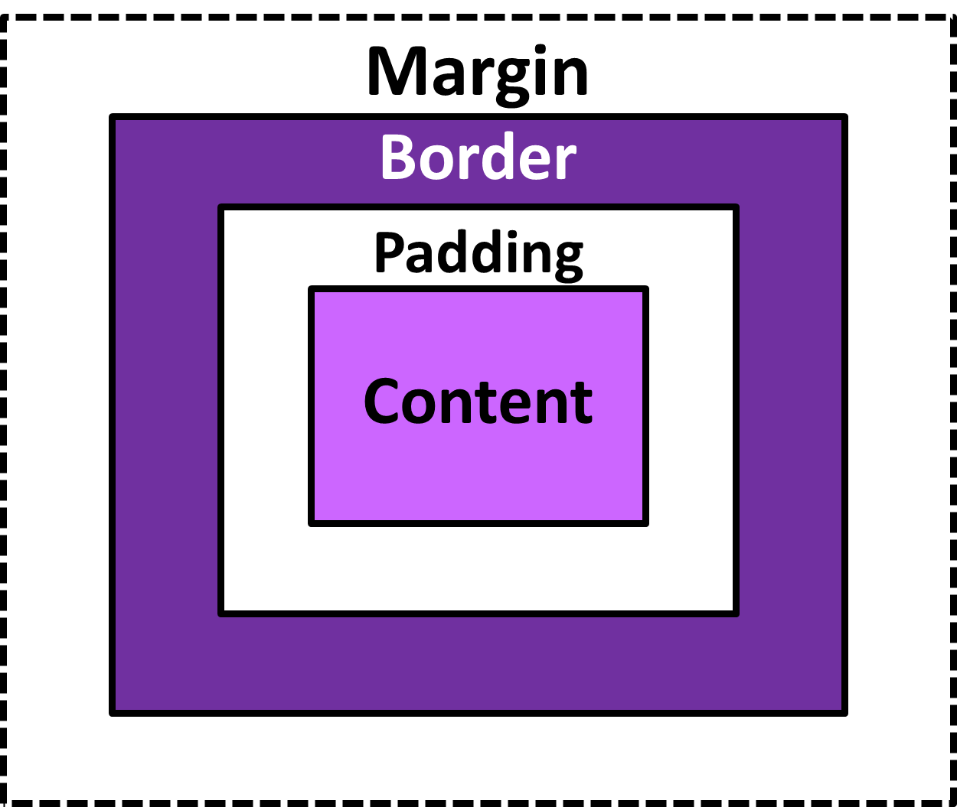
The Box Model
The Box Model wraps every CSS element in padding, border and margin – allowing developers to modify spacing styles.

Slide 19
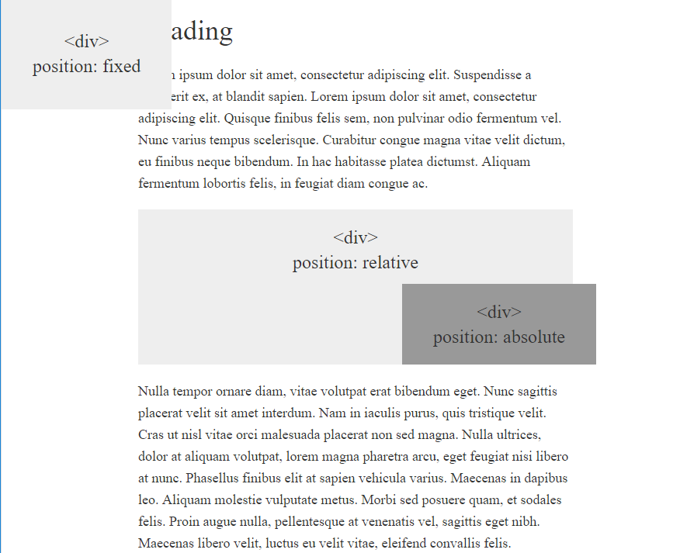
CSS Positioning
We can orient our HTML elements in relation to space with CSS positioning (static, relative, fixed, absolute).

Slide 20









How to Learn…

Slide 21

General Questions / Issues?

Slide 22
Double Take

Slide 23
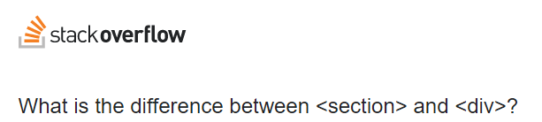
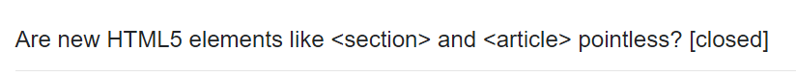
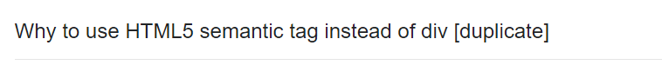

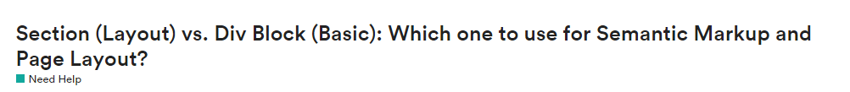
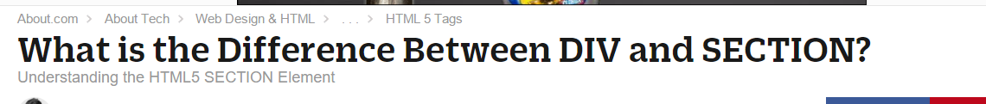
Divs, Sections, Navs, Etc….

Slide 24
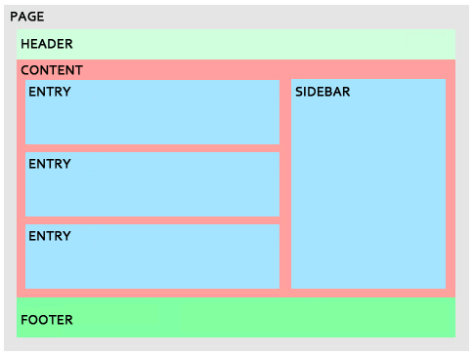
Divs, Sections, Navs, Etc….
All web layouts are inherently composed of containers, traditionally called “divs.”

Slide 25
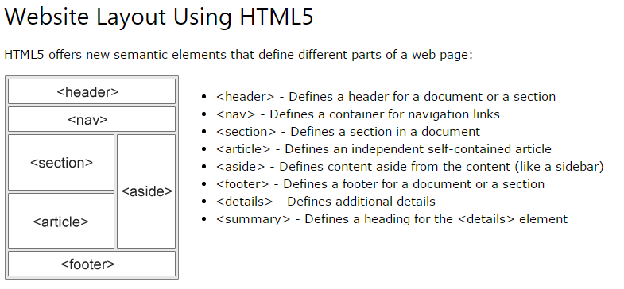
Divs, Sections, Navs, Etc….
HTML5 introduced the concept of “semantic layouts,” meaning “divs” could be given more meaningful names.
In theory, this helps with organization and search engine optimization.

Slide 26
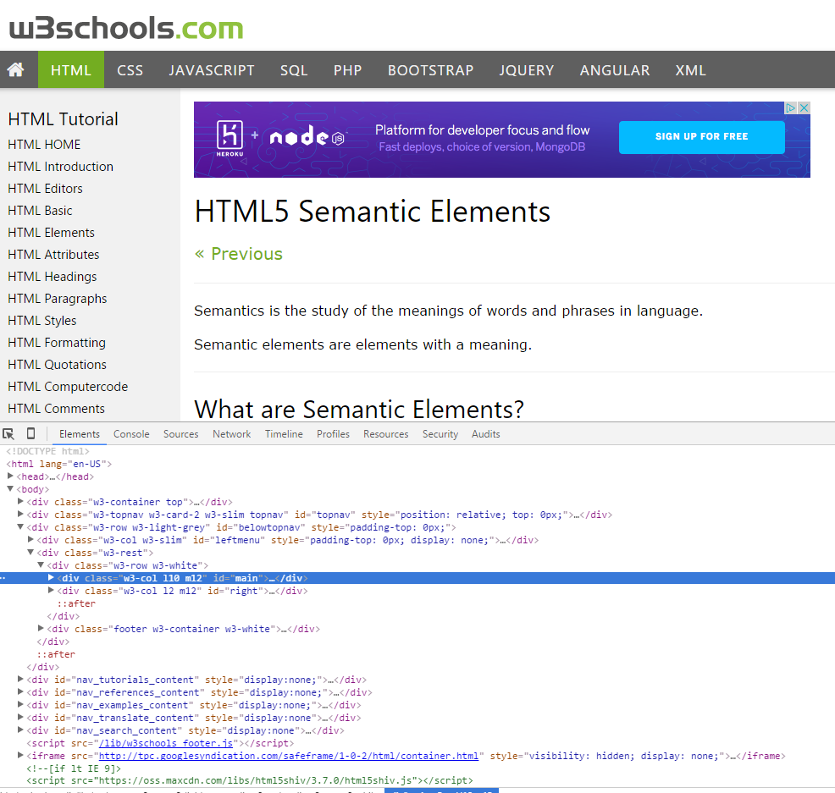
Divs, Sections, Navs, Etc….
That said… many (if not most) websites, seem to still be using basic divs.
There are reasons for this that we’ll showcase in later sections.
Additionally, it’s possible to include “semantics” by using id names and classes.

Slide 27
Divs, Sections, Navs, Etc….
div?
Section?
Bottom line:
Follow your homework’s instructions. But when you get out in the “real world,” follow the convention of where you work!

Slide 28

Classes vs. IDs
Classes = Barcode (all iPod)
IDs = Serial Number (unique iPod)
When choosing between a CSS ID and a CSS Class follow the convention:
Classes (.classname) are to be used if the same style will be used on multiple HTML elements.
IDs (#idname) are to be used if a style is unique to that HTML element.

Slide 29
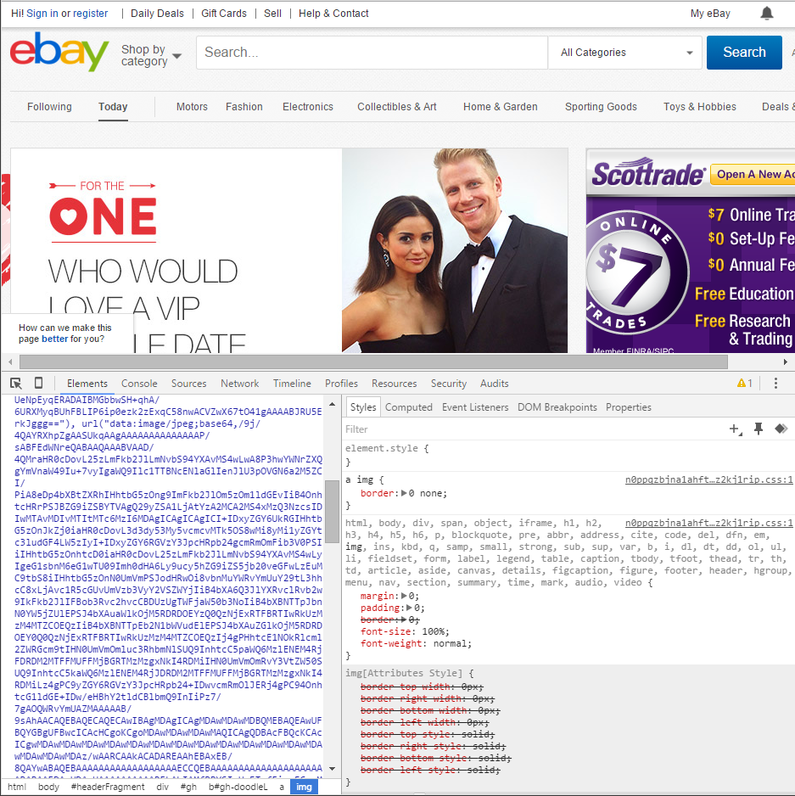
Chrome Developer Tools (Inspector)
This is one of the most frequent tools you will use in web development.
It allows you to truly debug your web designs.
Start using it!

Slide 30
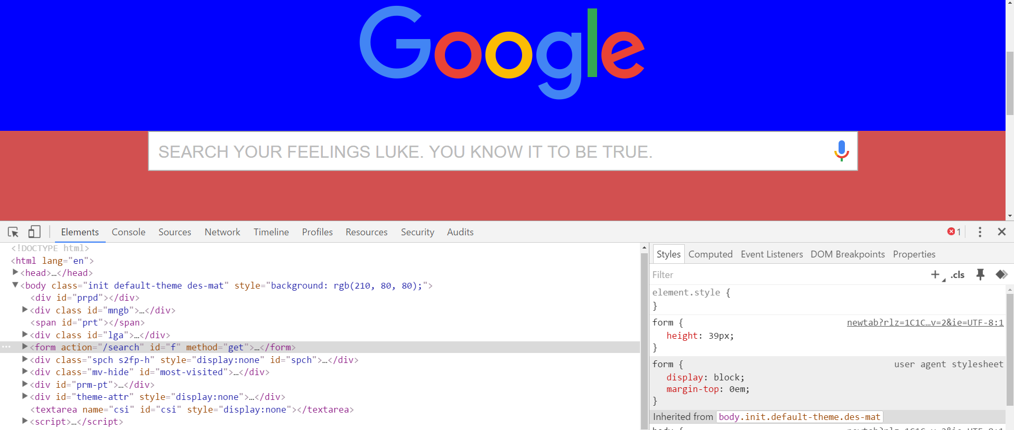
Modifying Sites
You can edit any page’s HTML and CSS with Chrome Developer Tools.
Plus, you’ll see your results instantly.

Slide 31
INSTRUCTOR DEMO!
Instructor: Demo
(Chrome Developer Tools)

Slide 32
> YOUR TURN!!
Suggested Time: 15 min
Assignment
For the next 15 minutes, take a website you commonly use (Amazon, Google, Huff Po, etc.) and heavily modify it using the Chrome Developer Tools.
Be sure to at least modify:
Content (Change words)
Colors
Spacing
Send a screenshot to the class’s slack profile when you’re done.

Slide 33
> YOUR TURN!!
Suggested Time: 10 min
Assignment
For the next 10 minutes, edit any site that you’ve been working on in-class or for homework with Chrome Developer Tools.
Be sure to at least modify:
Content (Change words)
Colors
Spacing

Slide 34
CSS Resets

Slide 35
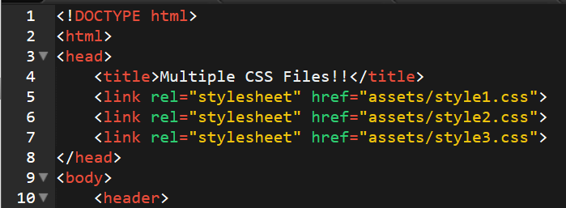
Loading Multiple CSS Files
***(Very Important!!!)***
An incredibly powerful technique: deploying multiple CSS files simultaneously.
This lets developers to create complex designs made up of abounding design elements.
Just remember: the loading order matters!!!

Slide 36
INSTRUCTOR DEMO!
Instructor: Demo
(1-3_CSSFiles.html | 3-MultipleCSS)

Slide 37
What Browser?
By a show of hands…
Which browser do you use?

Slide 38
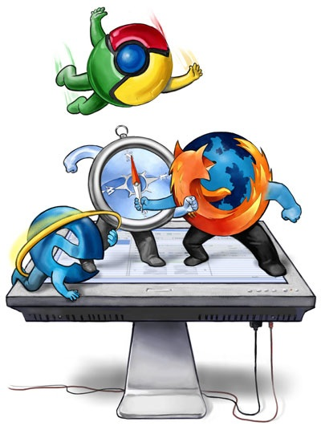
Battle of the Browsers
Under the hood, web browsers often render web pages differently than their competition.
These disparities could mean HTML/CSS displaying differently in each web client.
Because of these potential divergences, web developers need to make their websites cross-browser compatible.

Slide 39
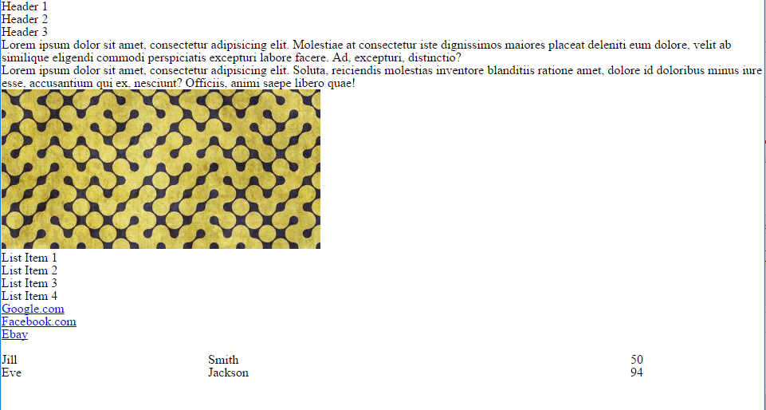
Reset.css (or Normalize.css)
Reset.css will “reset” all browser-specific CSS. This means your site will appear the same in all browsers.
However, you will have to re-style everything yourself.

Slide 40
INSTRUCTOR DEMO!
Instructor: Demo
(Example.html | 4-ResetCSS)

Slide 41
Why CSS Resets Matter
It’s important for creating browser-compatible websites
It’s an example of using someone else’s CSS in your website!!!
It’s a common Front-End Developer Interview question.

Slide 42
> YOUR TURN!!
Suggested Time: 10 min
Assignment
Follow the instructions given via Slack to incorporate a reset.css file into a basic HTML file.
Note the impact the reset file makes after its inclusion.

Slide 43
To the Web with GitHub!

Slide 44
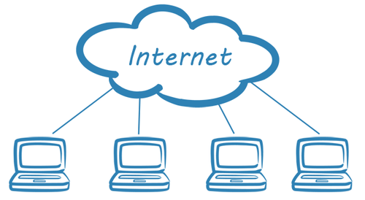
The Internet
A deep and complex diagram above on how the internet works.

Slide 45
The World Will See Our Greatness!
GitHub provides hosting for static websites – which means we can deploy our websites and applications onto their servers for the world to see.

Slide 46
Together Now…
Let’s all login to GitHub

Slide 47
INSTRUCTOR DEMO!
Instructor: Demo
(GitHub Pages Deployment - Personal)

Slide 48
Deploying Static Personal Site – GitHub Pages
Basic Steps:
On github: Create a new repo that is named `<username>.github.io`
Navigate into a folder and clone the repo into it
Build your files
Add, commit, and push your changes into the repository

Slide 49
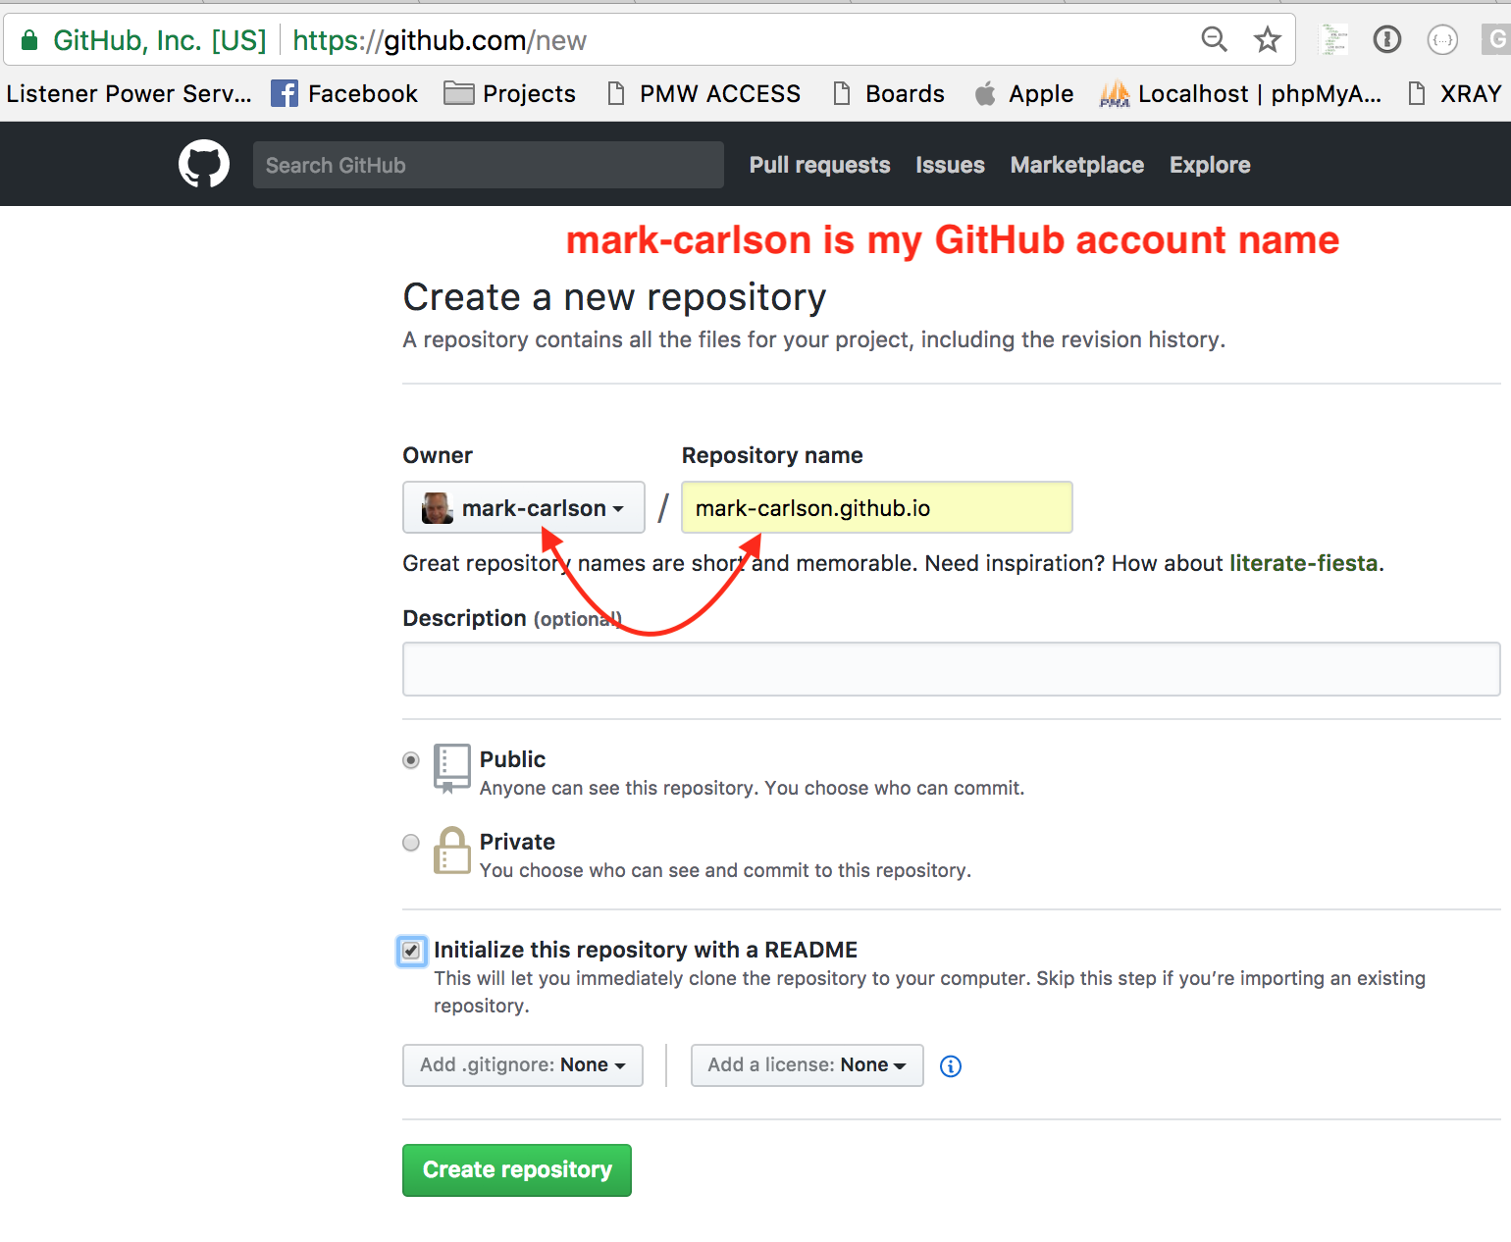
Step one: Create a repo with this name pattern

Slide 50
Step two: Go to your new repo’s settings

Slide 51
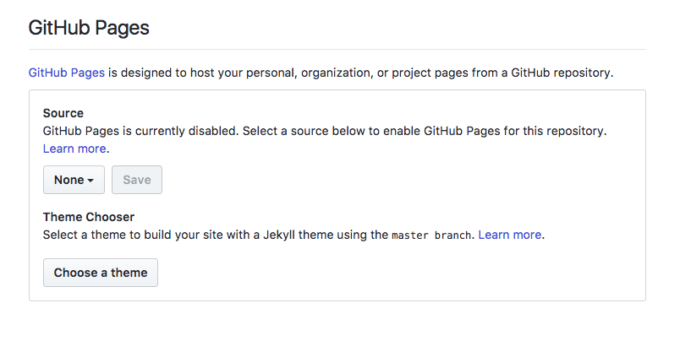
Step three: Scroll down to GitHub Pages

Slide 52
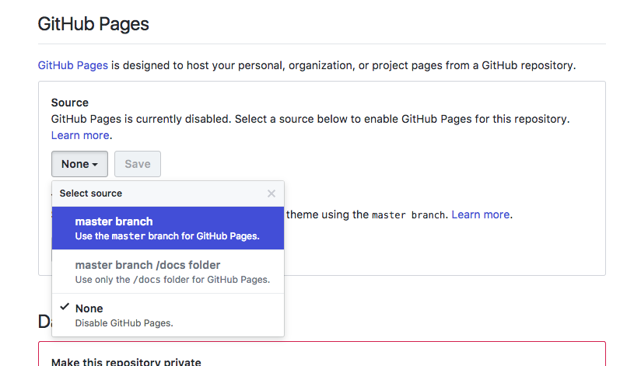
Step four: Select “Master” branch

Slide 53
Step five: Clone Your Repo
Clone your repo
Use your standard location - Adapt a standard location
Mine is ~/Documents/GitHubRepos
`git clone <myrepo>`

Slide 54
Step six: Git Repo Location
Try `git pull`. Did you get a “Fatal: Not a git repository… “ error?
Got into your repo: cd <myRepo> (Easy to forget! )
Yes, this is a folder name with periods in it.
`git clone <myrepo>`

Slide 55
Step seven: Make an HTML file in your repo
open Sublime text to that location
Create an index.html file
put ‘Hello World’ in it for now

Slide 56
Step eight: Get your content up on GitHub
git add .
git commit -m
git pull
(git pull is meaningless for now, but it should be a habit.)
Now visit: http://<myGitAccount>.github.io

Slide 57
> YOUR TURN!!
Suggested Time: 15 min
Assignment
Time to take your newfangled website and deploy it to the cloud (in this case, GitHub Pages).
Additional instructions to be sent via Slack.

Slide 58
INSTRUCTOR DEMO!
Instructor: Demo
(GitHub Pages Deployment - Project)

Slide 59
Deploying a Static Project Site – GitHub Pages
Basic Steps:
1. Create a new repository on your GitHub account. You can name this repository whatever you would like.
2. Once inside of the repository, create a new file and name it `index.html`
3. Add some very basic HTML into this file, save it, and then navigate into your repository's Settings tab.
4. Scroll down to the GitHub Pages section and then, in the section labeled "Source", select that you would like to use the master branch as your source.
5. Navigate to `<username>.github.io/<repositoryname>` and you will find that your new web page has gone live!

Slide 60
> YOUR TURN!!
Suggested Time: 15 min
Assignment
Build a newfangled website, and deploy it to GitHub Pages as a project instead of a personal site.
Additional instructions to be sent via Slack.

Slide 61
Practice Through Frustration
Keep Practicing!
It gets better.

Slide 62
Questions?

Slide 63
Homework 1 - Help?

Slide 64
EXTRA MATERIAL

Slide 65
And Back to Git…

Slide 66

The Group Project
OMG. I HAZ THE GREATEST HTML IDEA!!!!!
SpongeSite.com

Slide 67

The Group Project
Programming Away…
Spongebob’s idea is dumb. We should call it…
PrincezzzSite.com

Slide 68
The Group Project – Tragedy #1
The Group Project
Programming Away…
Now they have two completely different versions.
Programming Away…

Slide 69
The Group Project – Push vs Pull
Main Branch (Spongebob’s)
Spongebob continues programming
1
2
3
4
5
This is NON-IDEAL
Prince pushes his code changes into the main branch.
If Prince is allowed to push his code, it could seriously ruin Spongebob’s vision and working code.
Prince’s Branch

Slide 70
The Group Project – Push vs Pull
Main Branch (Spongebob’s)
Spongebob continues programming
1
2
3
4
5
Prince’s Branch

Slide 71
The Group Project – Push vs Pull
Main Branch (Spongebob’s)
Spongebob continues programming
1
2
3
4
5
Ideal Approach – Using Pull Requests
Because Spongebob controls the “master branch” he must elect to pull Prince’s Code. All Prince can do is submit a “pull request”
This is the ideal way to maintain code in version control.
?
Prince’s Branch

Slide 72
General Steps for Git Pull Requests
Create a new branch of on your local computer
git branch <BRANCH NAME>
Checkout that branch (locally) on your machine
git checkout <BRANCH NAME>
Add / Commit your changes (will automatically save to this branch)
git add –A
git commit –m “Comment”
Push your branch to GitHub
git push origin <BRANCH NAME>
Submit a Pull Request on GitHub
Other user must accept these changes on GitHub

Slide 73
INSTRUCTOR DEMO!
Git Pull Request

Slide 74
> YOUR TURN!!
Assignment
Time to take your newfound collaborative git skills to the real-world. Find a partner and follow the steps sent via slack to
Share each other’s code
Make modifications
Submit a Pull Request
Accept the Pull Changes

Slide 75
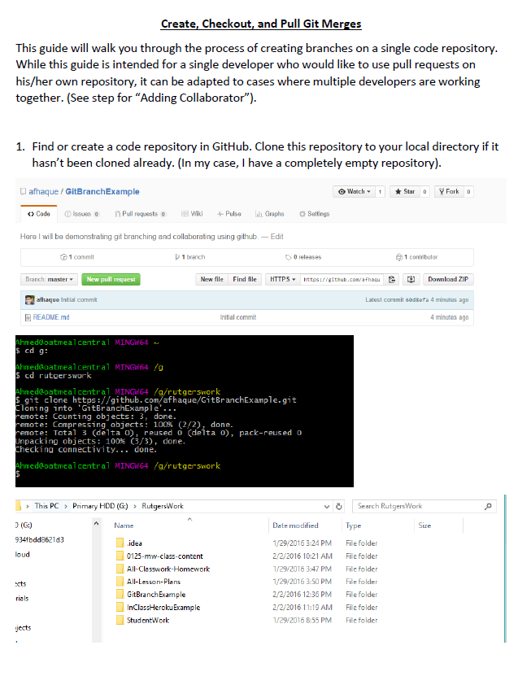
Follow our Guide!
Step-by-step guide
on creating Git Pull Requests

Slide 76
Don’t Worry!
We’ll be coming back to this.
You won’t need this fully until Week 8.

Slide 77
Practice At Home
But practice when you can!
You don’t need a partner to submit pull requests!

